Slide 1

Titanic Survival Analysis
A Multi-Tool Approach using Python, PostgreSQL, and Power BI

Slide 2

Project Objective
Goal
The Challenge
Identify key factors influencing survival rates on the Titanic.
Handling missing data effectively
Engineering meaningful features
Building a professional ETL pipeline

Slide 3




Technical Stack
Python
Pandas, NumPy, Seaborn for data manipulation & analysis
SQL
PostgreSQL, pgAdmin for robust relational database management
Data Visualization
Power BI for interactive dashboards and insights

Slide 4

Data Engineering & Cleaning (Python)
Feature Engineering
# Example Python Snippet df['Title'] = df['Name'].apply(get_title) df['Is_Alone'] = (df['SibSp'] == 0) & (df['Parch'] == 0) df['Family_Size'] = df['SibSp'] + df['Parch'] + 1 df['Has_Cabin'] = df['Cabin'].apply(lambda x: 0 if type(x) == float else 1)
Extracting titles for age imputation strategy
Creating 'Is_Alone' from 'SibSp' and 'Parch'
Deriving 'Family_Size' for group dynamics analysis
Identifying 'Has_Cabin' for location-based insights
Leveraging Python for robust data preparation.

Slide 5

Relational Database Integration (SQL)
01
02
Python to PostgreSQL
Schema Design
Seamless data migration from Python-processed dataframes to PostgreSQL.
Structuring tables for efficient querying and analysis.
03
Analytical Queries
Complex SQL queries for survival rates by fare categories and age bins.

Slide 6

Key Insight 1: The Gender & Status Gap
Initial analysis of survival data reveals a stark contrast based on gender and marital status. The historical "Women and Children First" maritime protocol appears to have significantly impacted outcomes.
Single Women
Single Men
Our data shows a 74% survival rate for single women compared to only 18.89% for single men. This validates the effectiveness of the "Women and Children First" directive during the Titanic disaster, showcasing a significant disparity in survival based on these demographic factors.

Slide 7
Key Insight 2: Socio-Economic Priority
62.96%
24.24%
1st Class Survival
3rd Class Survival
Higher privilege yielded significantly better survival chances.
Disadvantaged passengers faced much lower odds.
68.13%
24.89%
High Fare Survival
Low Fare Survival
Passengers paying more for tickets had better access to safety.
Affordability dictated proximity to escape routes and assistance.

Slide 8



Key Insight 3: The Power of Family
Survival Rates
Traveling Alone
With Family
Family groups had 20% higher survival rates
Traveling alone significantly reduced rescue chances
Group dynamics improved access to lifeboats and assistance
Family connections offered a crucial advantage in the chaos of the sinking.

Slide 9
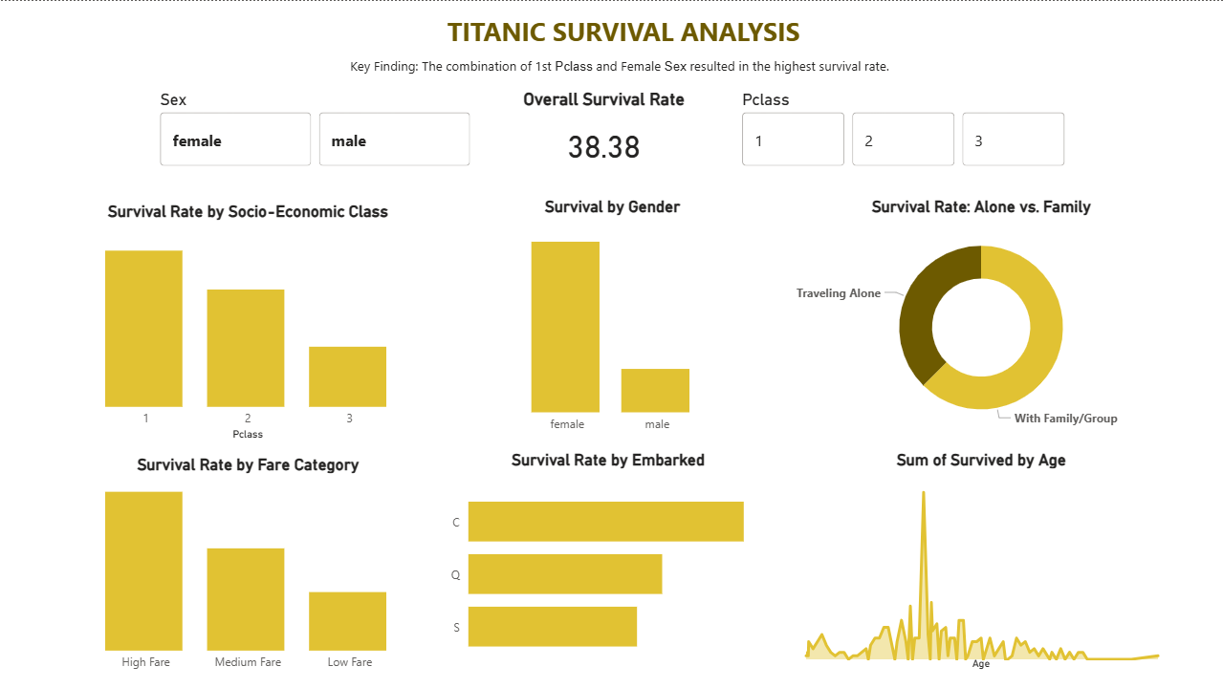
Executive Dashboard
Interactive and dynamic dashboard built in Power BI, enabling real-time exploration of survival factors. Visualise trends with ease.

Slide 10




Conclusion & Skills Demonstrated
Data Cleaning
Proficient in handling missing values and data inconsistencies.
ETL Pipeline
End-to-end data extraction, transformation, and loading.
SQL Querying
Advanced analytical querying for deep insights.
BI Storytelling
Translating complex data into actionable business intelligence.
This project showcases a comprehensive skill set in data science, from raw data to compelling insights.

